Slide 1
It’s a Type of Magic
#CTD2019
Yacine Mekesser
Notes:
There will be some math involved today, so you have the chance now to run, before it’s too late.

Slide 2

Just JavaScript with type annotations?
Notes:
First: Why typescript?
Typescript is one of the most commonly used Javascript «Dialects».
Especially if you work with Angular, you will probably use typescript, but it is also often used for React.
Many times when I see people write typescript, they basically just write JavaScript and add some type annotations. There is nothing wrong with that, typescript being a superset of Javascript enables and even encourages this of course.
But typescript has more under the hood than what is visible on first glance. It has a very powerful, nifty type system that rivals these of big mainstream languages.
In fact, it is much more inspired by functional languages like Scala or Haskell.

Slide 3
Generics
Literal Types
Intersection types
Union Types
Mapped Types
Conditional Types

Slide 4
Typescript Config
Minimum config for type safety:
Variables are non-nullable unless explicitly stated
Expressions and declarations cannot be any unless explicitly stated
Enable all strict type checking options with “strict”: true
{
"compilerOptions": {
"strictNullChecks": true,
"noImplicitAny": true,
// ...
}
}

Slide 5

Why Type-Safety?
Let the compiler help you!
Prevents several classes of bugs
Less testing effort
Self-documentation
Can be fun too!
Notes:
The main idea is that you let the compiler help you.
You can prevent several classes of bugs already at compile-time.
I don’t only mean just some null-pointer exceptions, but you can also prevent actual bugs in the business logic if you craft your types carefully
You can completely rule our invalid data for your functions, making your code shorter, simpler, and more reliable.
It also has the benefit that by narrowing down the possible values a function takes, you also have to test less.
You do not need to write a unit test for a case where a null is passed to a function, when it doesn’t accept it.
So you end up needing fewer tests, yet having more reliable code
It is also helpful in having clean, readable code. Think of it this way. Especially if you have pure functions, without any side effects, the functions signature tells you everything. It is a simple interface telling you what goes in and what goes out. By having explicit and specific types, you refine that interface and improve therefore the understandability of your code.
And it can be fun ☺
Especially because you get immediate feedback. The compiler, or the IDE, will tell you if your program is correct without ever running it.

Slide 6
Goals
Get an intuition for types as a concept
See some examples how to use type features of TS effectively
Learn about ADTs
Notes:
We will look at some code and example applications today. But more than just a few patterns, it is important to me to give you an

Slide 7
Structure
1. Types as Sets
2. Basic Types
3. Combining Types
4. Discriminated Unions
5. ADTs
Notes:
The goal is to understand Algebraic Data Types and see some of their usages.

Slide 8
Types as Sets

Slide 9

Types as Sets
Looking at types as sets helps to understand the underlying concepts
What is a Set? A collection of Objects
What is a Type? A class of Objects confining to a set of constraints
Types can be described with simple algebra
Notes:
They can come in big and small
To make it more entertainable, I will be displaying sets as colourful blobs with faces

Slide 10
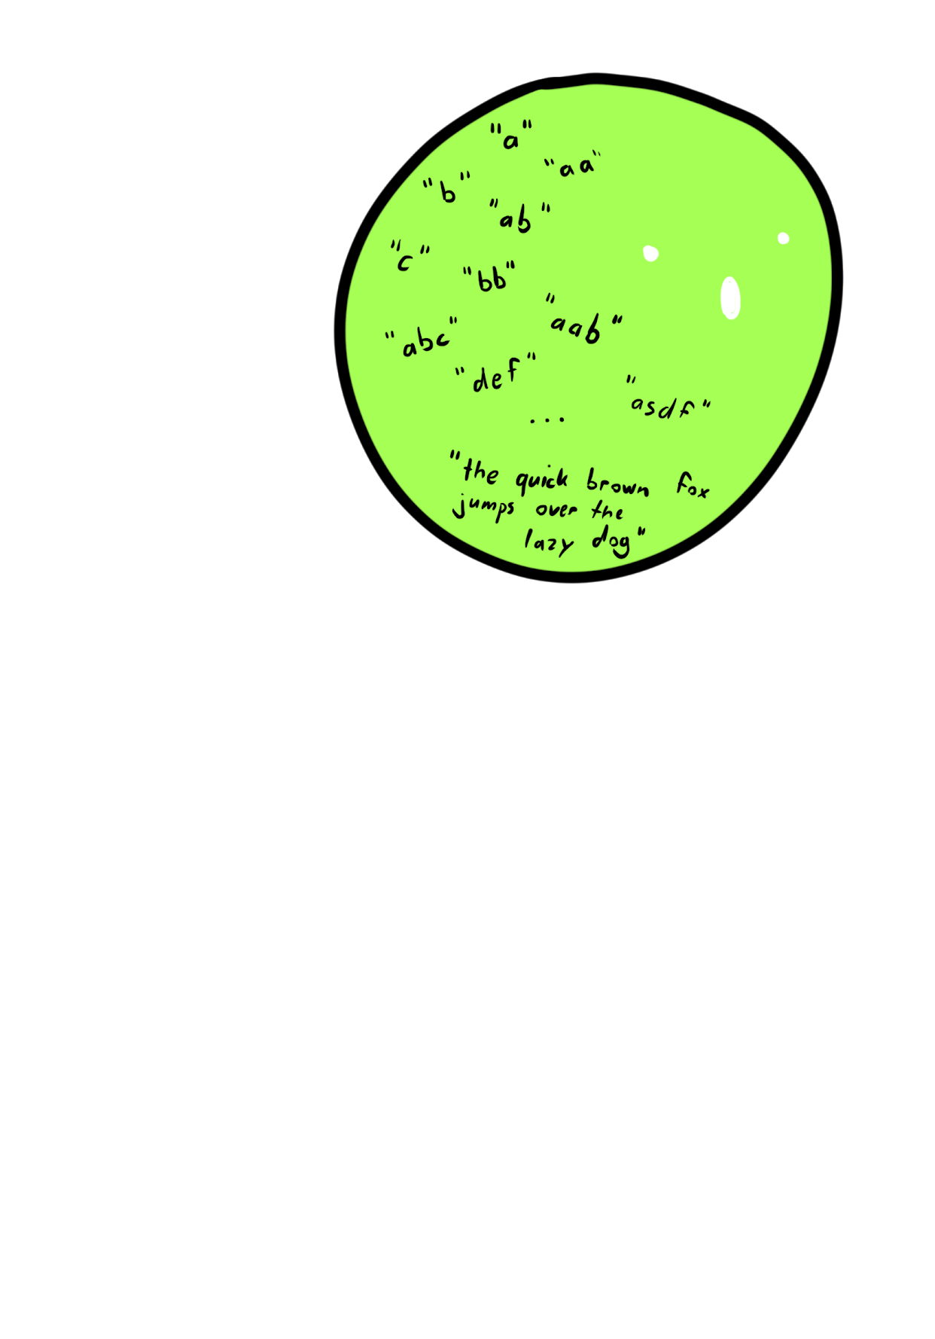
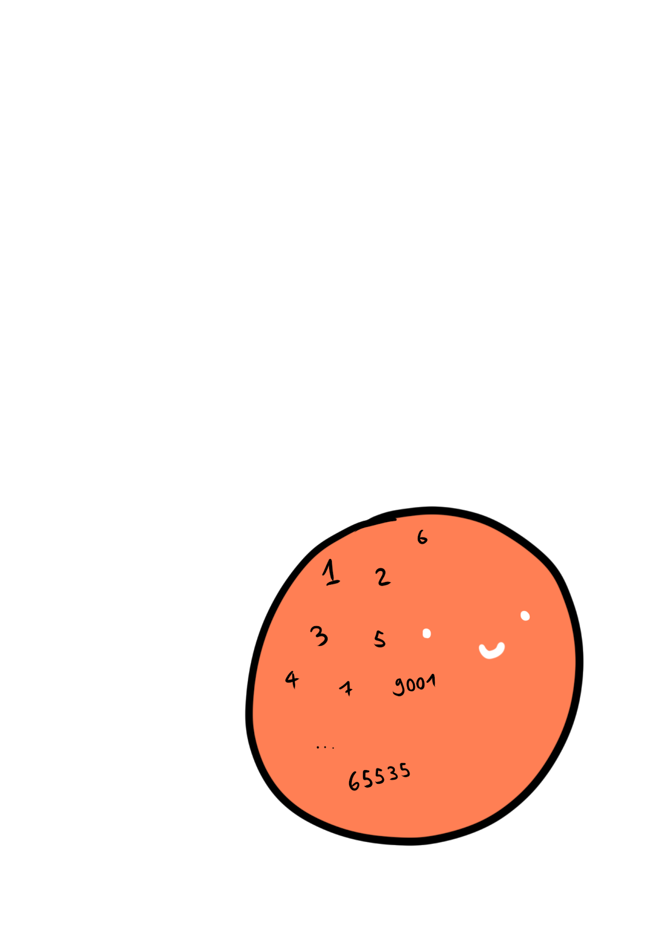
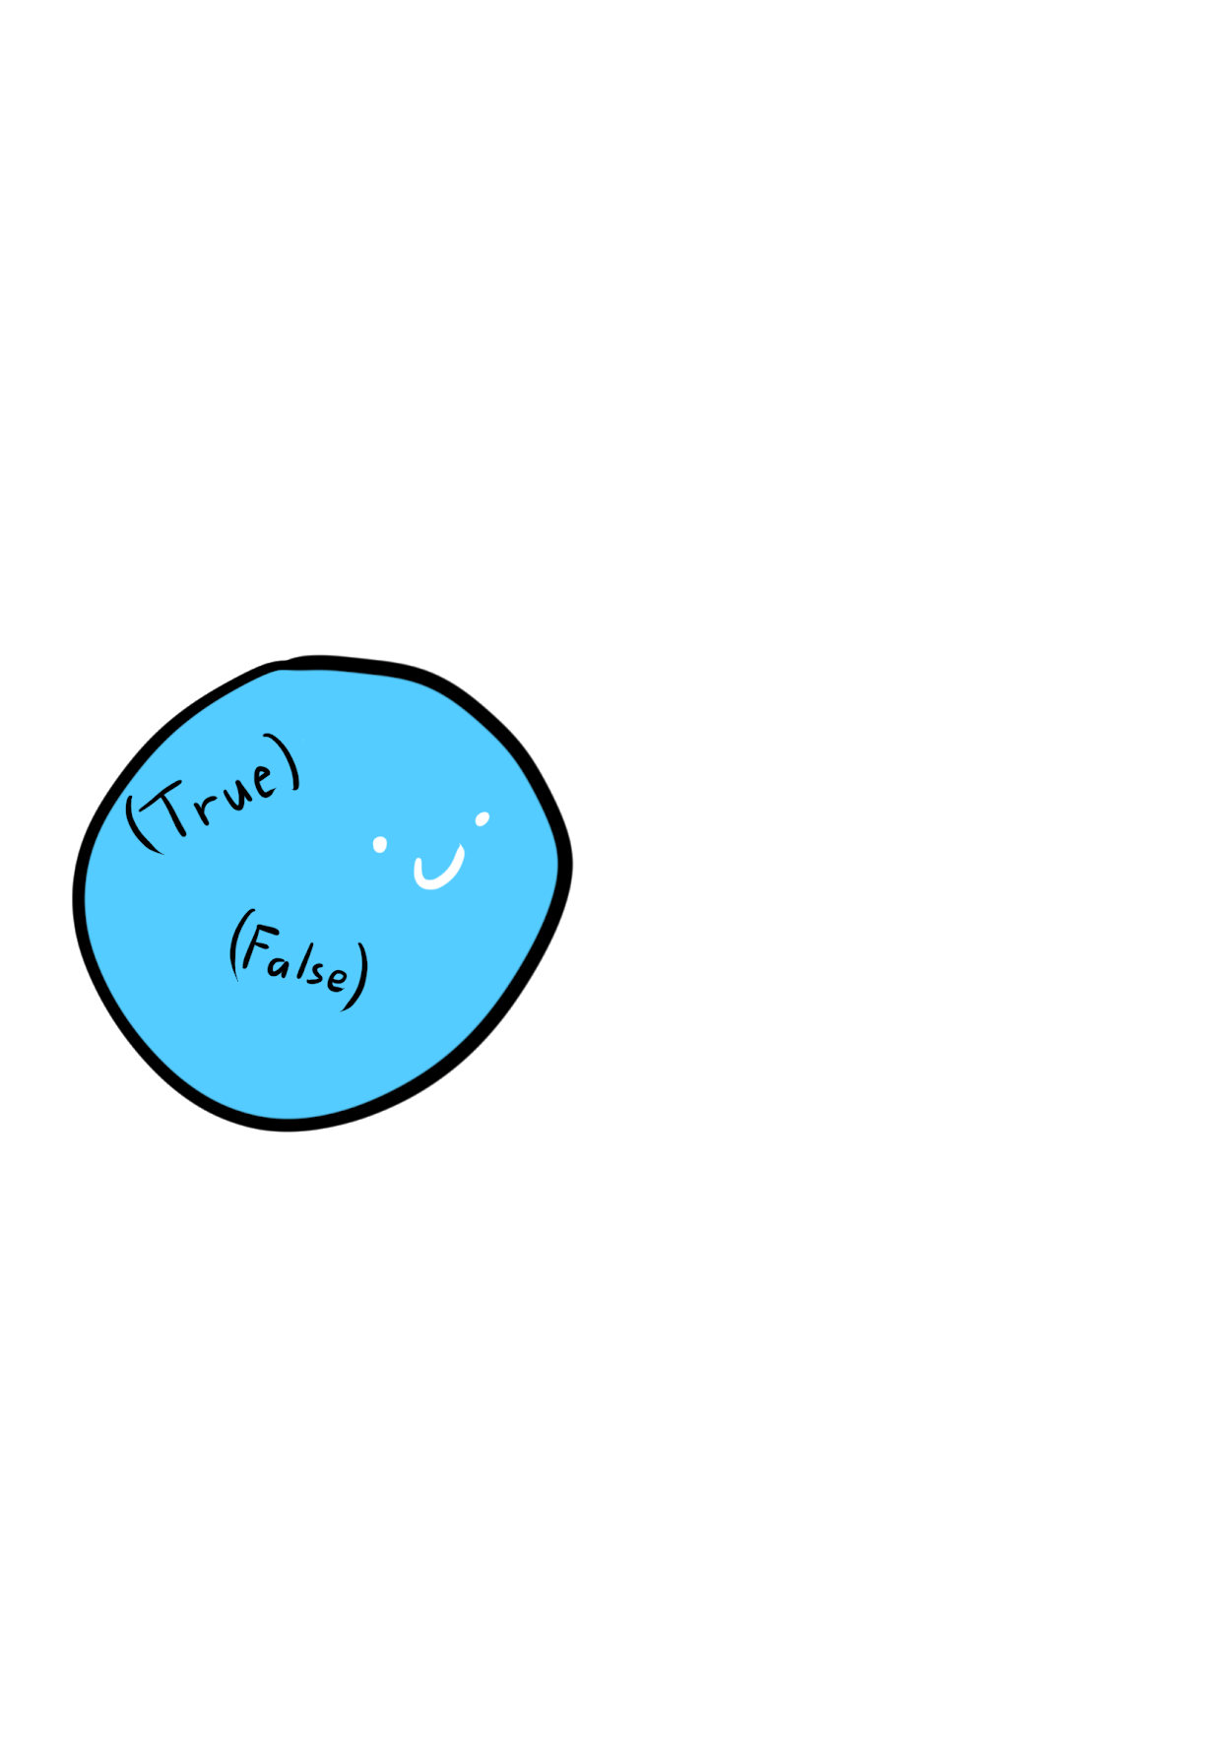
Intuition: Counting inhabitants
Boolean?
Integer?
String?
Notes:
The “count” of elements in a set is sometimes also called “cardinality”

Slide 11
Structural Type Equality
C#, Java, etc: Nominal type systems
TypeScript, Haskell, Elm: types are defined by their shape, not their names
type A = { foo: string };
type B = { foo: string };
const a: A = { foo: "bar" }
const b: B = a; // no compile error, type A is equal to B
Notes:
In nominal type systems, types are differentiated by their name
In TypeScript, they are defined by their shape.
If the shape is equal, the types can be used interchangeably, no matter what the name is.
Assigning a name to a type, is actually called a “Type Alias”

Slide 12
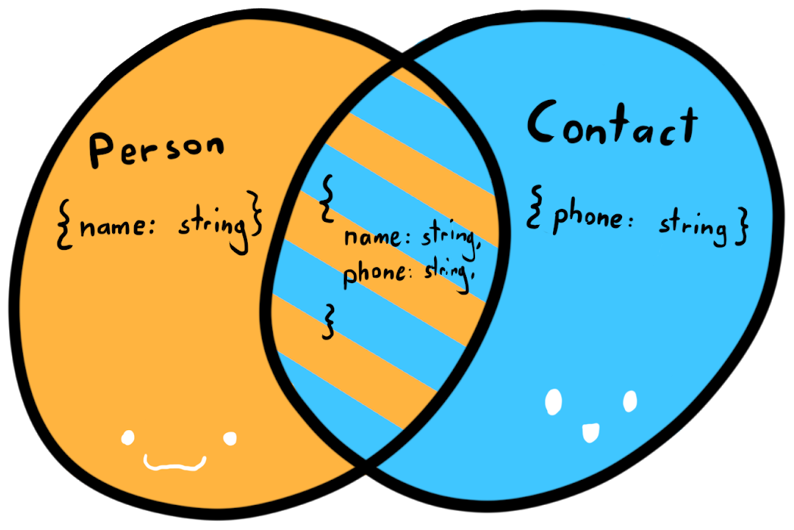
Structural Type Equality
declare function call(c: Contact): boolean;
var personWithContact = {
name: "JoJo",
phone: "079 123 45 67"
};
call(personWithContact);
Types can also overlap
personWithContact is a subtype of both Person and Contact
Notes:
personWithContact is a subtype of both Person and Contact, even though this is nowhere stated explicitly

Slide 13
Basic Types

Slide 14
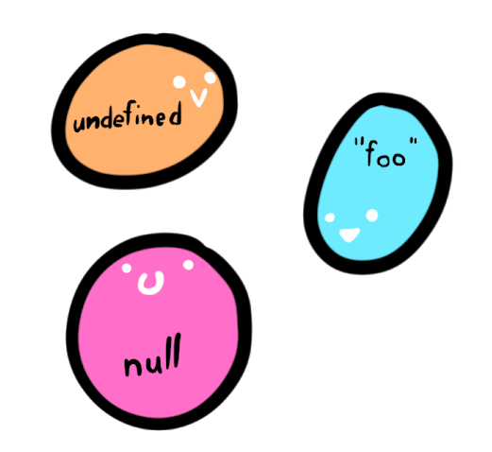
Singleton Types
Types with only one inhabitant
In Typescript:
let u; // undefined
let a = null; // null
const x = "foo"; // "foo"
Type Literals
const y = 5; // 5
Notes:
There is exactly one way to construct a singleton type.
There is undefined and null (and void) There are string literals and number literals

Slide 15
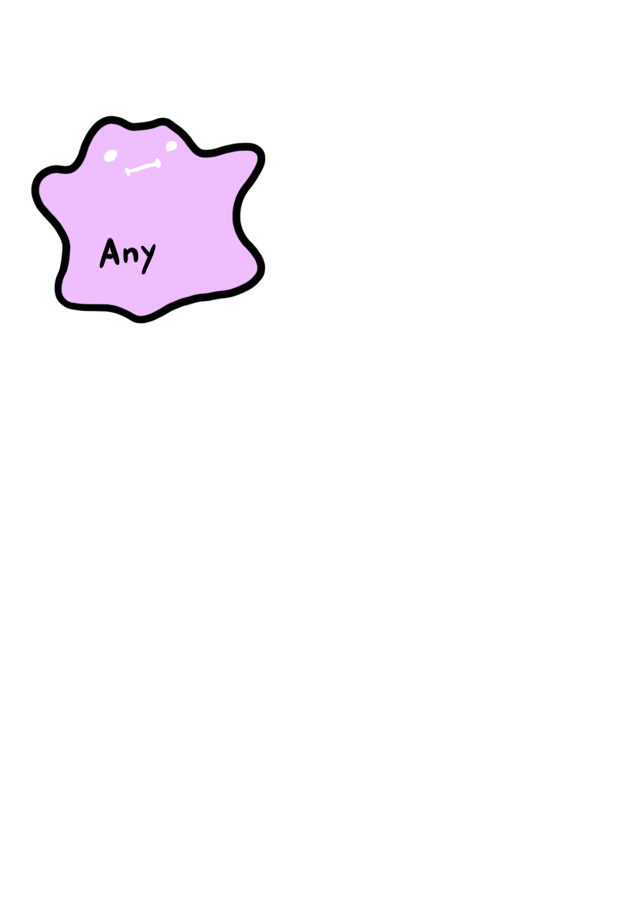

Top Types
Also universal supertype, contains every possible value, equals the universal set U
In typescript: any and unkown
let c: any = "foo";
c.someFunction();
let d: number = c;
let e: unknown = 42;
e.toString() // type error
let f: string = e; // type error
Notes:
Any is the escape hatch of the type system.
It means you don’t care what it is and nobody should tell you otherwise
All types are assignable to it and you can assign it on everything
Unknown is the type-safe counterpart to any since typescript 3.0
You have to do type checks first, before performing any operation on it
All types are assignable to it, but you cannot assign it to anything (except any)
Both types are very useful when interoping with plain javascript
The unknown type is recommended to use

Slide 16
Example of using unknown
type Duck = { walkSpeed: number, quack: () => string };
function tryQuack(x: unknown) {
return x.quack();
}
Operations on an object of type unknown are not allowed
Notes:
Let’s say we have a function tryQuack that is called from unsafe code, so we do not know if we really get a duck object. So we declare the parameter as unknown
This prevents us from unsafely calling the quack() function, which could lead to a runtime error

Slide 17
Example of using unknown
Type guard
type Duck = { walkSpeed: number, quack: () => string };
function isDuck(thing: unknown): thing is Duck {
return typeof (thing as Duck).walkSpeed === "number"
&& typeof (thing as Duck).quack === "function";
}
function tryQuack(x: unknown) {
if (isDuck(x)) {
return x.quack();
}
console.log("Wasn't a duck, sorry.")
}
The compiler knows that x must be of type Duck
Notes:
What we can do is define a typeguard (note the return value) which tells the compiler how to confirm that an object really is of type Duck

Slide 18

Bottom Type
A type that contains no values, equals the empty set Ø
Has several interesting applications, similar to 0 in algebra
If the typescript compiler ever reaches a never, it will not compile
let g: never = ({} as any); // Error
Notes:
Reaching a never is impossible. Think of it this way: There are 0 ways to construct never.

Slide 19
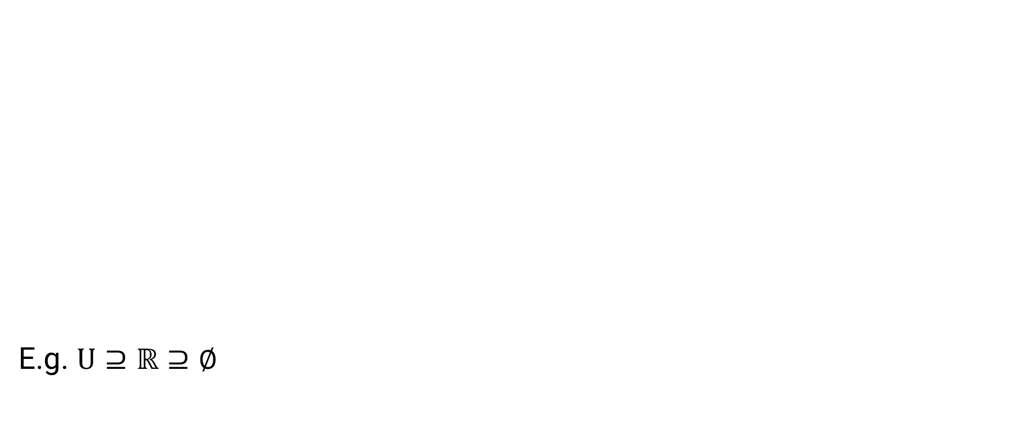
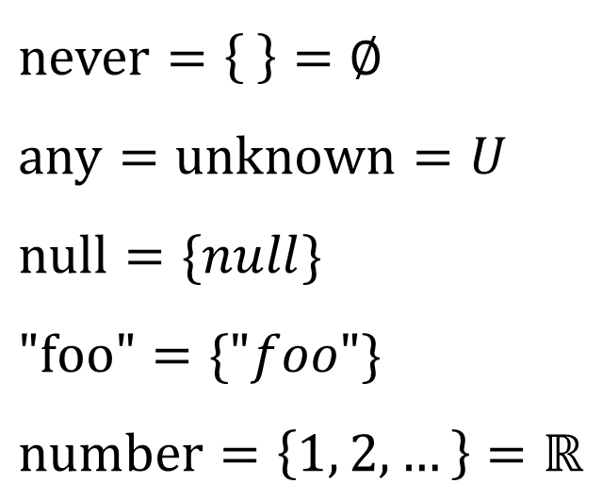
Basic Types as Sets: Summary
$$\text{never}=\left\{ \right\}=∅ \\ \text{any}=unknown=U \\ \text{null}=\{null\} \\ "\text{foo}\text{"}=\{"foo"\} \\ \text{number}=\left\{1, 2, …\right\}=ℝ$$
E.g. $\text{U}⊇ℝ⊇∅$
Notes:
Never is the empty set
Any and unknown are the universal sets
Literal types are sets with just one element
Number equals the set of real numbers

Slide 20
Combining Types

Slide 21
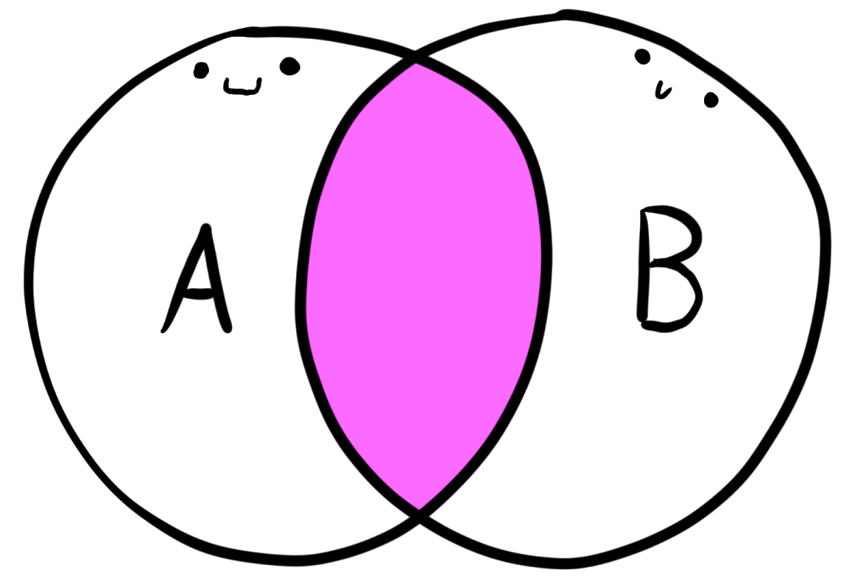
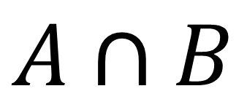
Intersection Type
$$A∩B$$
As sets:
Objects of an intersection type must contain properties of both types
type Person = { name: string, age: number }
type Contact = { phone: string }
let i: Person & Contact = {
name: "JoJo",
age: 17,
phone: "079 123 45 67",
};
Notes:
An intersection type equals the intersection of sets
That’s why it’s an ampersand, it says it is a Person AND a Contact

Slide 22
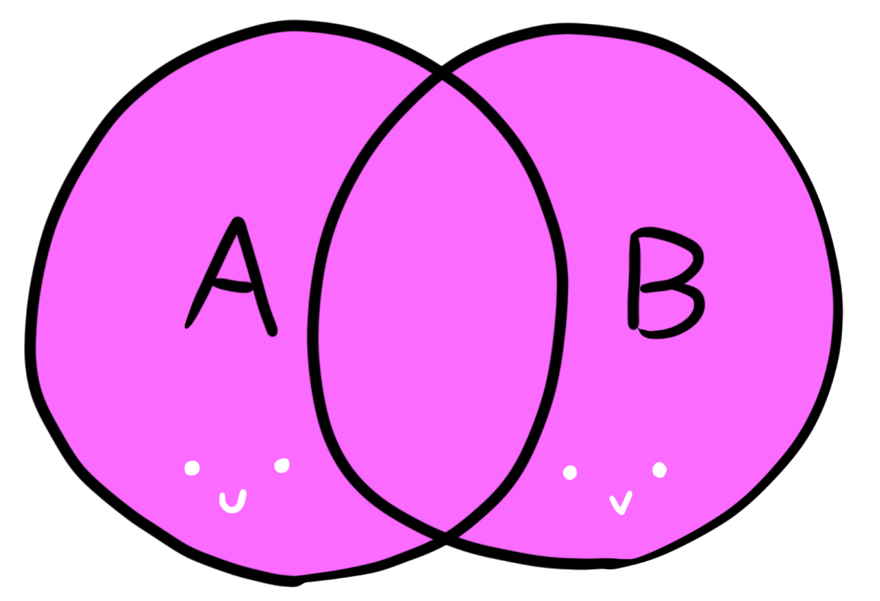
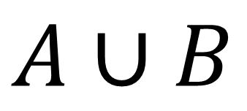
Union Type
$$A∪B$$
As Sets:
The object can be either of the two types
let h: string | number;
h = "hello";
h = 42;
type Workdays = "Mon" | "Tue" | "Wed" | "Thu" | "Fri";
type Weekdays = Workdays | "Sat" | "Sun";
type MyBoolean = true | false; // MyBoolean = boolean
Notes:
Types can be disjunct as well
The resulting type can be either A or B… or BOTH. It it includes objects from BOTH sets
If I define this variable h as a string | number
It is both valid to assign a string value or a numeric value.
In many languages you cannot be more granular than to say you expect a string
With union types and type literals combined, you can in typescript.
That’s very useful, if you want to limit the set of possible values. It’s very similar to an enum, although more lightweight.
The same works with numbers too (and with booleans, but that’s not terribly useful)

Slide 23
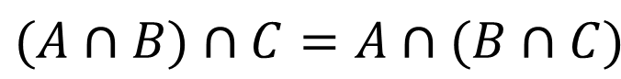
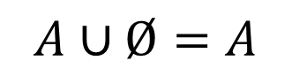
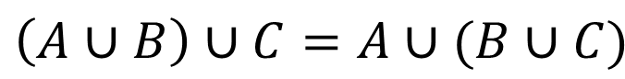
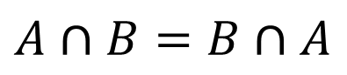
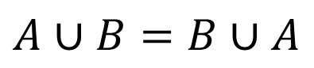
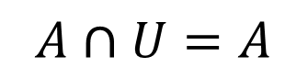
Some set algebra
Identity Laws:
Commutativity: Associativity:
$$A∪Ø=A$$
type X = number | never; // X = number
type Y = number & unknown; // Y = number
$$A∩U=A$$
$$A∪B=B∪A$$
$$\left(A∪B\right)∪C=A∪(B∪C)$$
$$A∩B=B∩A$$
$$(A∩B)∩C=A∩(B∩C)$$
type A = "foo" | "bar";
type B = "bar" | "foo";
let a: A = "foo";
let b: B = "bar";
a = b;
type E = ( A | B) | C;
type F = A | (B | C);
let e: E = "foo";
let f: F = "bar";
e = f;
Notes:
With
All expected laws from set algebra apply to

Slide 24
Example of using Union Types
function double(x: number | string) {
return x * 2;
}
A string cannot be multiplied
Notes:
A bit a contrived example: We have a function double that should double both numbers and strings
But a string object cannot be multiplied

Slide 25
Example of using Union Types
function double(x: number | string) {
if(typeof x == "number") {
return x * 2;
}
return (2 * Number(x)).toString();
}
The control flow analysis infers the type of x in both cases
Notes:
What is the return type of this function? It is also number | string

Slide 26
Discriminated Unions

Slide 27
Opaque Types
The structural type equality can stand in our way
Sometimes we want to differentiate values with identical structure
type Username = string;
type Password = string;
const displayUserName = (u: Username) => `User: ${u}`;
const pw: Password = "hunter2";
displayUserName(pw); // valid, but not what we want
Notes:
In this example, we have to strings, but they represent two very different business objects.
Can we somehow use the type system to prevent the misuse of the password?

Slide 28
Opaque Types
How to make your types “Opaque”?
Type Literals
Intersection Types
These types are now (structurally) different!
type Username = string & { type: "Username" };
type Password = string & { type: "Password" };
const displayUserName = (u: Username) => `User: ${u}`;
const pw: Password = "hunter2" as Password;
displayUserName(pw); // compiler prevents us from misusing sensitive data

Slide 29
Opaque Types
Can be made even cleaner with mapped types
The compiler prevents us to use a password value where we shouldn’t
type Opaque<K, T> = T & {_type: K};
type Username = Opaque<"Username", string>;
type Password = Opaque<"Password", string>;
const displayUserName = (u: Username) => `User: ${u}`;
const pw: Password = "hunter2" as Password;
displayUserName(pw); // A-OK!

Slide 30
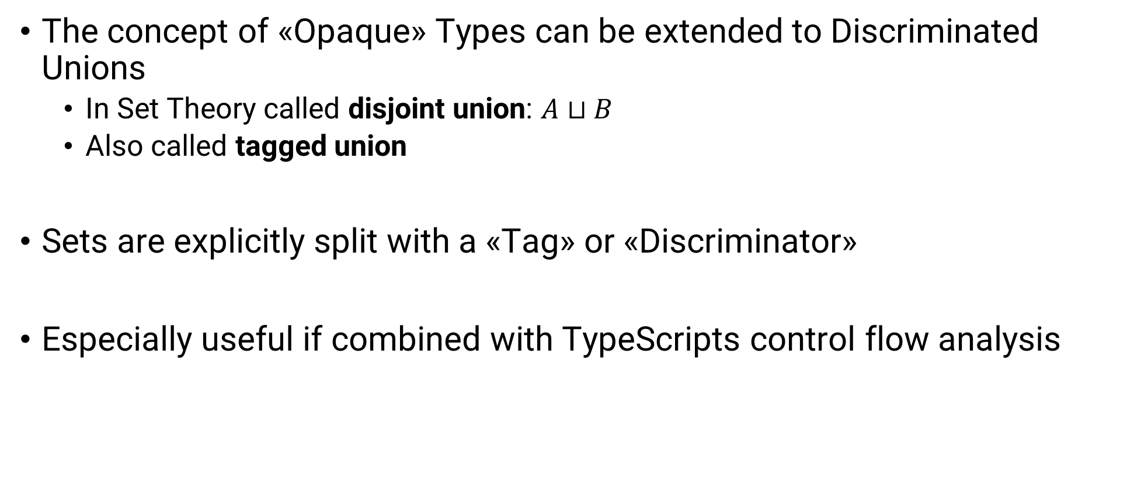
Discriminated Unions
The concept of «Opaque» Types can be extended to Discriminated Unions
In Set Theory called disjoint union: $A⊔B$
Also called tagged union
Sets are explicitly split with a «Tag» or «Discriminator»
Especially useful if combined with TypeScripts control flow analysis

Slide 31
Example of using Discriminated Unions
type InitAction = { type: "INIT" }
type LoginAction = { type: "LOGIN", name: string, password: string }
type Actions = InitAction | LoginAction;
function handleAction(action: Actions) {
switch (action.type) {
case "INIT":
return "Initialized";
case "LOGIN":
console.log(action.name + " logged in");
return "Logged In"
default:
console.log("WTF");
}
}
Property “name” can be safely accessed here
Notes:
Note: The discriminator is the “type” property

Slide 32
Exhaustiveness Checking
We often have types that cover several cases
What if you can guarantee that you cover them all?
Benefits:
Cut down bugs
Make extending functionality easier

Slide 33
Example of using Discriminated Unions
type InitAction = { type: "INIT" }
type LoginAction = { type: "LOGIN", name: string, password: string }
type LogOutAction = { type: "LOGOUT" }
type Actions = InitAction | LoginAction | LogOutAction;
function handleAction(action: Actions) {
switch (action.type) {
case "INIT":
return "Initialized";
case "LOGIN":
console.log(action.name + " logged in");
return "Logged In"
default:
console.log("WTF");
}
}
We don’t handle all cases anymore!

Slide 34
Example of using Discriminated Unions
type InitAction = { type: "INIT" }
type LoginAction = { type: "LOGIN", name: string, password: string }
type LogOutAction = { type: "LOGOUT" }
type Actions = InitAction | LoginAction | LogOutAction;
function handleAction(action: Actions): string {
switch (action.type) {
case "INIT":
return "Initialized";
case "LOGIN":
console.log(action.name + " logged in");
return "Logged In"
default:
console.log("WTF");
}
}
Compiler complains: Function returns string | undefined
Notes:
One possibility to handle this case:
Specify the return type explicitly.
The compiler will complain, because we do not return a string in all cases.
There is one case where we don’t return at all, so the result is «undefined»
As the function potentially returns either of these types, the inferred return type is «string | undefined»
that is not compatible with the specified «string» return type
But what if we WANT to return undefined in some cases?
Then this doesn’t work.
There is another solution though…

Slide 35
Another Example of using Union Types
type InitAction = { type: "INIT" } ...
type Actions = InitAction | LoginAction | LogOutAction;
function assertNever(x: never): never {
throw new Error("Unexpected object: " + x);
}
function exhaustiveHandleAction(action: Actions) {
switch (action.type) {
case "INIT":
return "Initialized";
case "LOGIN":
console.log(action.name + " logged in");
return "Logged In"
default:
return assertNever(action);
}
}
The compiler complains if it ever reaches this point✔️
Notes:
We define a new function that returns never
Remember: never is a type that contains NO values. So it is not valid to instantiate it.
So this function is absurd, as it cannot ever reach an end point where it would return.
Easy solution: We throw an error in the function. (the inferred return type is automatically «never»).
The compiler will complain as soon as we would ever potentially call this function.
So the code will only compile, if we handled all cases.

Slide 36
Algebraic Data Types

Slide 37
Algebraic data types
Algebraic data types (ADTs) are composite types with algebraic properties
Most common classes: Products and Sums
We want:
Type Checking
Exhaustivity

Slide 38
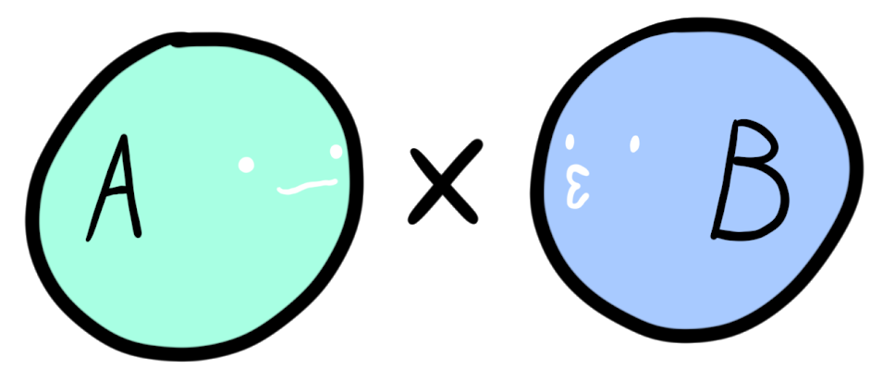
Product Types
Is equal to the carthesian product of sets
Can be modelled as a Tuple:
Or, more explicit, as an object with two properties:
let p: [number, boolean] = [5, true];
type Product<A, B> = { fst: A, snd: B };
let prod: Product<number, boolean> = { fst: 5, snd: true };
Notes:
Of course you are not confined to two values, you can have arbitrarily many. It’s just the simplest case.

Slide 39
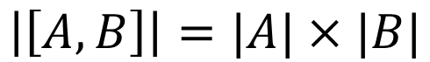
Product Types
Why «Product»?
Try counting the inhabitants
$$\left|\left[A,B\right]\right|=|A|×|B|$$
Notes:
A Product can also be understood as an AND in logic
The product of a type A and B contains every combination of A values and B values.
In the example before: We can have every number with true and every number with false. This means 2 times the amount of valid numbers

Slide 40
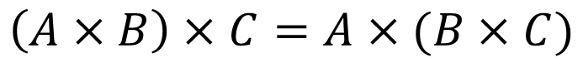
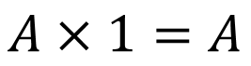
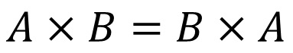
Product Types
Does other algebra apply? Commutativity:
let p1: [A, B] = ["A", "B"];
let p2: [B, A] = ["B", "A"];
$$A×B=B×A$$
const swap = ([x, y]) => [y, x];
Associativity:
$$\left(A×B\right)×C=A×(B×C)$$
let p2: [A, [B, C]] = ["A", ["B", "C"]];
let p3: [[A, B], C] = [["A", "B"], "C"];
const f = ([a, [b, c]]: [A, [B, C]]) => [[a, b], c];
const f_inv = ([[a, b], c]: [[A, B], C]) => [a, [b, c]];
let p4 = ["A", null];
const rho = ([a, _]: [any, null]) => a;
const rho_inv = (a: any) => [a, null];
Neutral-Element:
$$A×1=A$$
Notes:
A Product can also be understood as an AND in logic
Commutativity is given, up to isomorphism.
This means, that we can have a simple function that maps one side to the other and vice versa, without losing any information.
In this case of swap it is even its own inverse.
For associativity there is also a simple function that maps p2 to p3.
The neutral element in Products in numbers is 1. In Sets it is any singleton element. We just have tuples of a value from type A combined with a constant. You can define very simple functions that map a value to such a product ype.
And there is more, but let’s leave it at that just to form the intuition

Slide 41
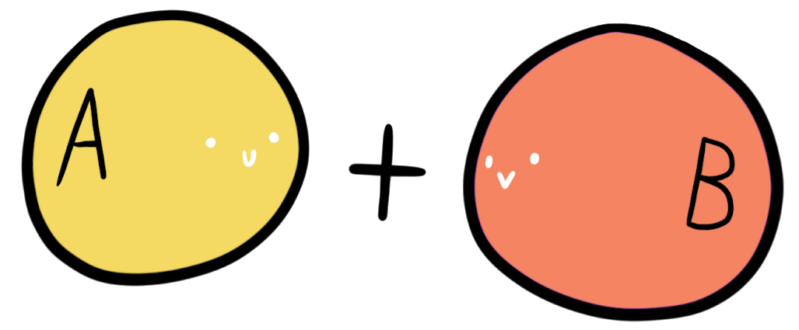
Sum Types
Sum types aren’t a native language feature of TS
But they can be built with discriminated unions
The sum type is also known as «Either»
type Left<T> = { type: "Left", val: T };
type Right<T> = { type: "Right", val: T };
type Sum<A, B> = Left<A> | Right<B>;
type Either<A, B> = Sum<A, B>;
Notes:
The sum type can also be understood as an XOR

Slide 42
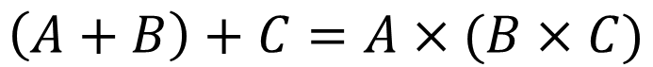
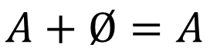
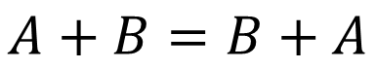
Sum Types
Does other algebra apply? Commutativity:
$$A+B=B+A$$
type S1 = Sum<"A", "B">;
type S2 = Sum<"B", "A">;
function swapSum(s: Sum<"A", "B">): Sum<"B", "A"> {
return s.type == "Left"
? { type: "Right", val: s.val }
: { type: "Left", val: s.val };
}
Associativity:
$$\left(A+B\right)+C=A×(B×C)$$
Neutral-Element:
$$A+Ø=A$$
const s: Sum<string, never> = { type: "Left", val: "foo"};
const roh = <T>(x: Sum<T, never>): T => x.val;
const roh_inv = <T>(x: T): Sum<T, never> => ({ type: "Left", val: x });
Notes:
Commutativity does apply again up to isomorphism.
Same for associativity, but the two isomorphism-functions are bit unwieldy though. It is in the repository
The neutral element, with numeric additions this would be 0, is the empty set. In types it’s the sum with «never». This is again very easy to show

Slide 43
Type Algebra: Distributivity
(A x (B + C)) = (A x B) + (A x C)
type X<A, B, C> = [A, Either<B, C>];
type Y<A, B, C> = Either<[A, B], [A, C]>
function prodToSum<A, B, C>([x, y]: [A, Either<B, C>]): Either<[A, B], [A, C]> {
if (e.type === "Left") {
return { type: "Left", val: [x, y.val] }
} else {
return { type: "Right", val: [x, y.val] }
}
}
function sumToProd<A, B, C>(x: Either<[A, B], [A, C]>): [A, Either<B, C>] {
if (x.type === "Left") {
return [x.val[0], { type: "Left", val: y.val[1] }]
} else {
return [x.val[0], { type: "Right", val: y.val[1] }]
}
}
Notes:
Even distributivity is given.
It is a bit hard to read, but complies well

Slide 44
Type Algebra
Numbers | Types
0 | Never
1 | undefined, null, «foo»
a + b | Either<A, B> = Left<A> | Right<B>
a x b | [A, B], Product<A, B> = [A, B]
2 = 1 + 1 | type bool = True | False
1 + a | Optional<A> = «nothing» | Some<A>
Logic | Types
False | never
True | undefined, null, «foo»
a || b | Either<A, B> = Left<A> | Right<B>
a && b | [A, B], Product<A, B> = [A, B]

Slide 45
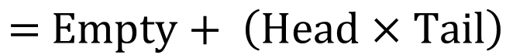
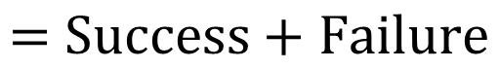
Applications
Many common data structures can be modelled as ADTs
type Success = { value: string, correlationId: number };
type Failure = { error: string };
type Response
= { type: "success", value: Success } | { type: "failure", value: Failure };
$$\text{= }\text{Success}+\text{Failure}$$
// Empty + (Head x Tail)
type List<T> = Either<"Empty", { head: T, tail: List<T> }>;
$$\text{= }\text{Empty}+ \left(\text{Head}\text{ × }\text{Tail}\right)$$

Slide 46
Example: Query Service
type Found<T> = { status: "Found", value: T };
type NotFound = { status: "Not Found" };
type Error = { status: "Error", message: string };
type QueryResult<T> = Found<T> | NotFound | Error;
function query<T>(sql: string): QueryResult<T> {
// ...
}

Slide 47
Example: Query Service
function handleResult<T, U>(
result: QueryResult<T>,
found: (r: Found<T>) => U,
notFound: (r: NotFound) => U,
) {
switch (result.status) {
case "Found":
return found(result);
case "Not Found":
return notFound(result);
case "Error":
return printError(result.message);
default:
assertNever(result);
}
}

Slide 48
Example: Query Service
function handleResult<T, U>(
result: QueryResult<T>,
found: (r: Found<T>) => U,
notFound: (r: NotFound) => U,
) { ... }
function getPetNames(personName: number): string[] | undefined {
return handleResult(
query<Person>(`Select * FROM Person WHERE name = ${personName}`),
foundPersonResult => handleResult(
query<Pet[]>(`Select * FROM Pet WHERE ownerId = ${foundPersonResult.value.id}`),
foundPetResult => foundPetResult.value.map(pet => pet.name),
_ => [],
),
_ => [],
);
}

Slide 49
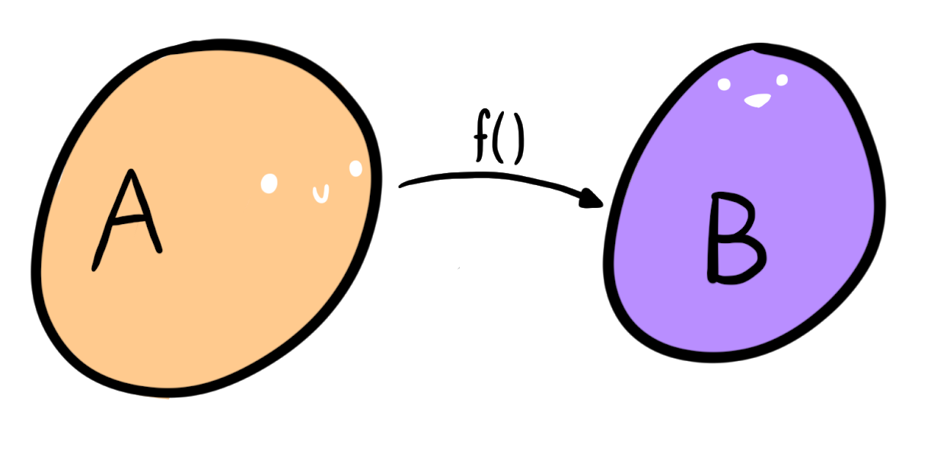
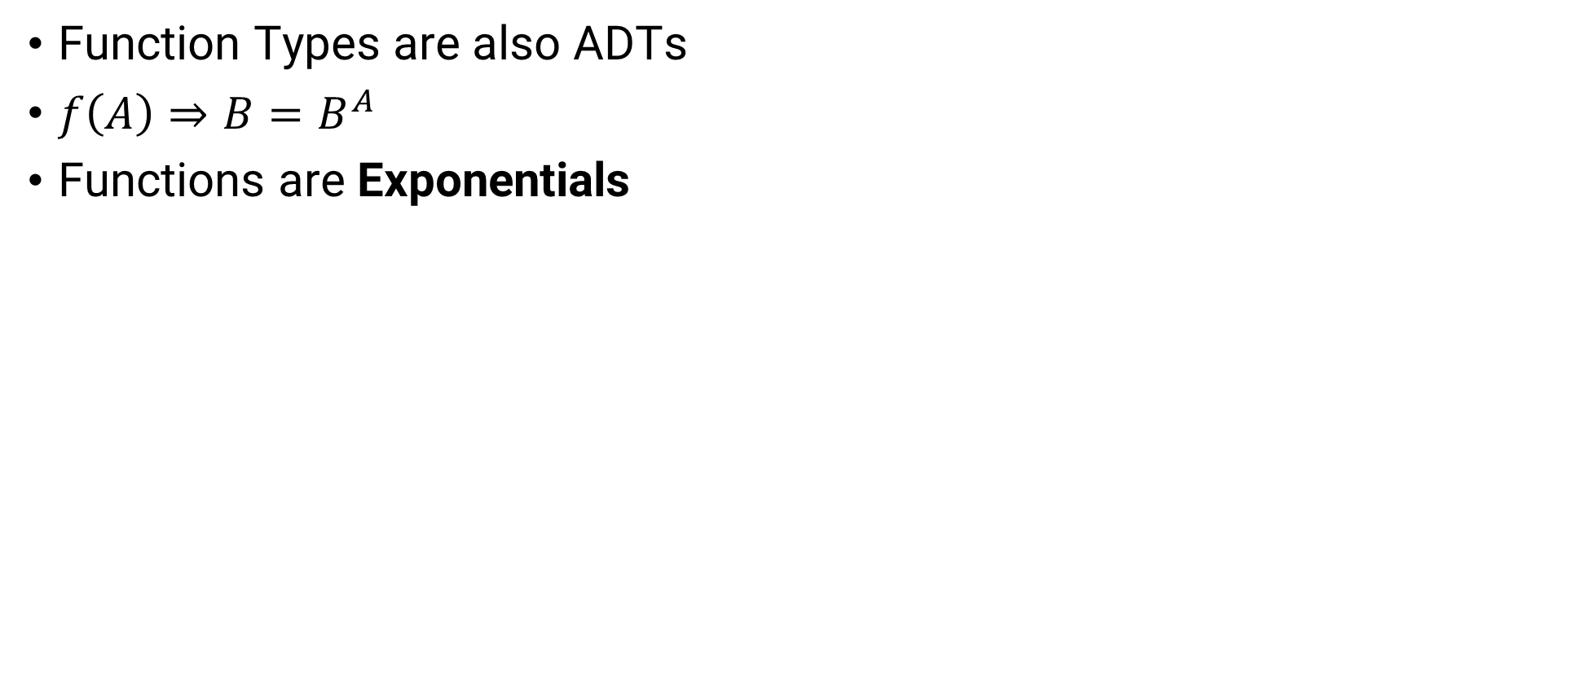
Bonus round: Set of Functions
Function Types are also ADTs
$f\left(A\right)⇒B=B^{A}$
Functions are Exponentials

Slide 50
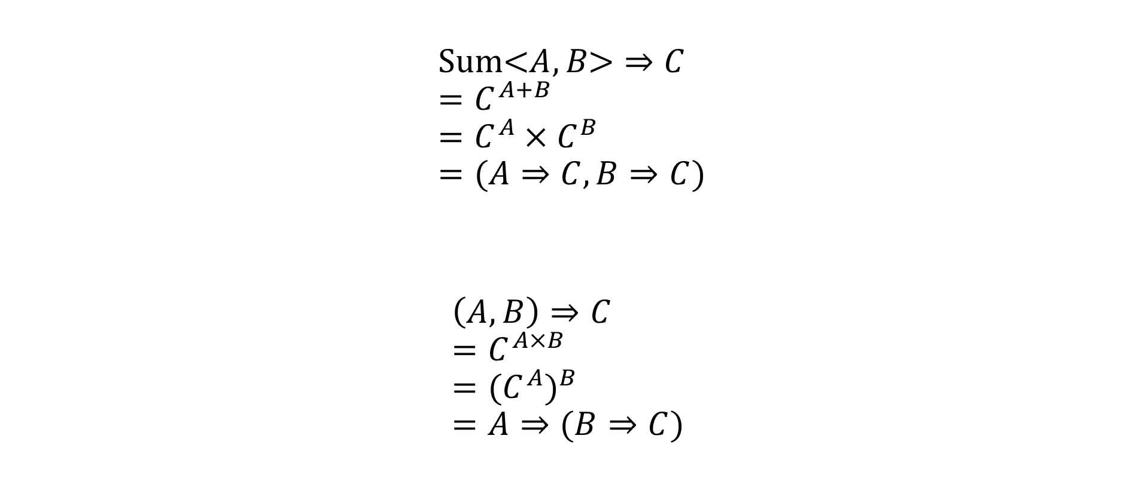
Bonus round: Set of Functions
$$\text{Sum}\text{<}A,B\text{>}⇒C \\ =C^{A+B} \\ =C^{A}×C^{B} \\ =(A⇒C, B⇒C)$$
$$\left(A, B\right)⇒C \\ =C^{A×B} \\ ={(C^{A})}^{B} \\ =A⇒(B⇒C)$$
Oops we’ve just proven currying

Slide 51
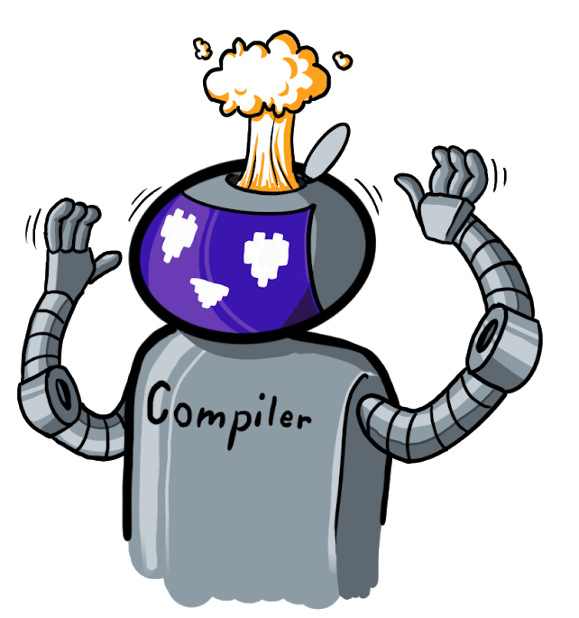
Conclusion
We have a powerful, functional-language-level type system built into JavaScript, one of the most used, handiest languages of our time

Slide 52

Thanks!
#CTD2019
Yacine Mekesser
Notes:
There will be some math involved today, so you have the chance now to run, before it’s too late.

Slide 53
Reading List
https://www.typescriptlang.org/docs/handbook/advanced-types.html
https://bartoszmilewski.com/2014/10/28/category-theory-for-programmers-the-preface/
Git repository of this presentation incl. code samples: https://github.com/ymekesser/a-type-of-magic-presentation

